Slide 1
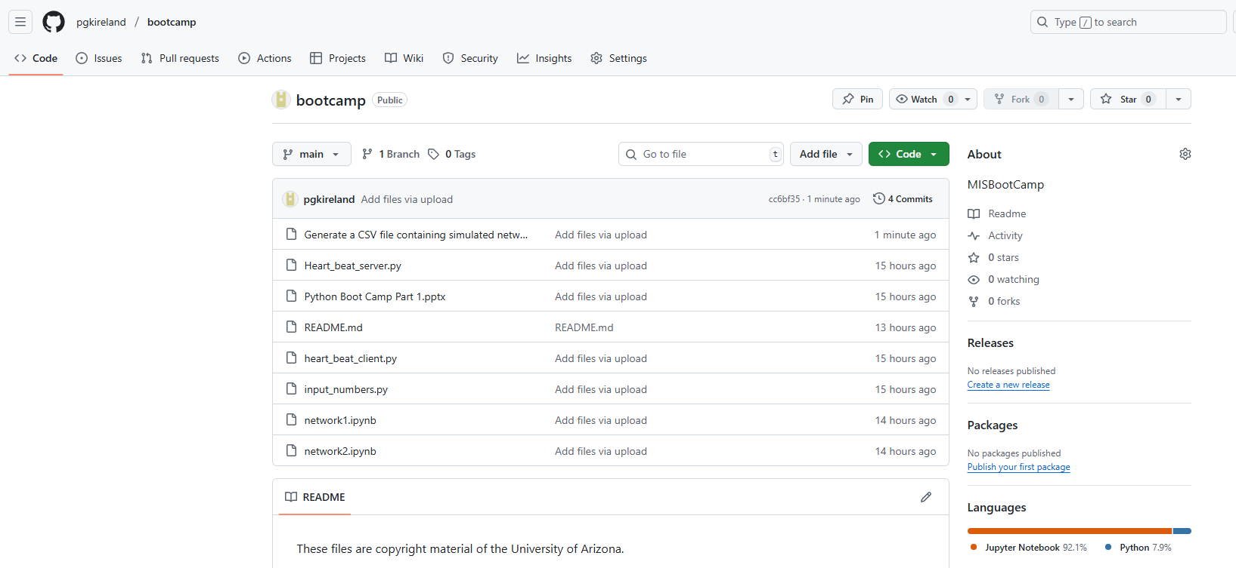
Python Boot Camp
Part 2
https://github.com/pgkireland/bootcamp

Slide 2
Python Exercise
After this exercise, you should be able to:
Work with user input in Python
Work with conditional statements and loops
Work with File objects and file methods

Slide 3
Python Exercise
In this exercise, you will develop a simple python program that will accept numbers from user and store them in a file.
You will write a simple python program input_numbers.py that satisfies the following requirements:
It should accept an integer from the user.
If user inputs any invalid datatypes (other than integer) display error message and prompt for input again.
Write the number to a new line in a file named “numbers.txt” in the same folder as input_numbers.py.
Ask if the user wants to continue- Yes/No.
If user inputs 'Yes', repeat steps-1 to 4 until user inputs 'No'.

Slide 4
The Programs 5 Goals
1.This program first creates a file object in write mode.
2.Then, it prompts the user for a number. If the number is an integer, the program writes the number to the file.
3.The program then asks the user if they want to continue.
4. If the user inputs 'Yes', the program repeats steps 1 to 3.
5.If the user inputs 'No', the program terminates.

Slide 5
The Program
Here is an example of how the program would work:
Enter a number: 10
Do you want to continue? (Yes/No): Yes
Enter a number: 20
Do you want to continue? (Yes/No): No
In this example, the user inputs 10 and 20. The program writes these numbers to the file "numbers.txt". The user then inputs 'No', so the program terminates.

Slide 6
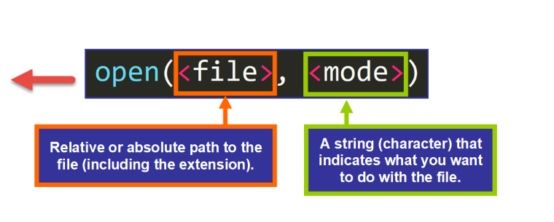
The Code - Part 1
def input_numbers():
# This function accepts numbers from the user and stores them in a file. Functions are named blocks of code that are designed to do one specific job.
# Create a file object in write mode w. The as keyword is used to create an alias f.
with open("numbers.txt", "w") as f:
# Prompt the user for a number.
number = input("Enter a number: ")

Slide 7
The Code - Part 2
# Check if the number is an integer. The try block lets you test a block of code for errors.
The except block lets you handle the error.
Python ValueError is raised when a function receives an argument of the correct type but an inappropriate value.
try:
number = int(number)
except ValueError:
# If the number is not an integer, display an error message and prompt for input again. The return keyword is to exit a function and return a value.
print("Invalid input. Please enter only an integer.")
return

Slide 8
The Code - Part 3
# Write the number to the file. The /n in a string, means the line ends at this point and right after it, a new line starts. The write() method writes the specified text to the file.
f.write(str(number) + "\n")
# Ask if the user wants to continue. The input() function allows user input. The prompt is a String, representing a default message before the input.
continue_input = input("Do you want to continue? (Yes/No): ")

Slide 9
The Code - Part 4
# If the user inputs 'Yes', repeat steps 1 to 3. Python includes the special variable called __name__ that contains the scope of the code being executed as a string. __main__ is the name of the top-level scope in which top-level code executes.
if continue_input == "Yes":
input_numbers()
if __name__ == "__main__":
input_numbers()

Slide 10
Indentation
Indentation refers to the spaces at the beginning of a code line.
Where in other programming languages the indentation in code is for readability only, the indentation in Python is very important.
Python uses indentation to indicate a block of code. Python will give you an error if you skip the indentation:
The number of spaces is up to you as a programmer, the most common use is four, but it has to be at least one.
You have to use the same number of spaces in the same block of code, otherwise Python will give you an error:

Slide 11
Comments
Python has commenting capability for the purpose of in-code documentation.
Comments start with a #, and Python will render the rest of the line as a comment: You cannot use return to continue the comment
# This is a comment.
print("Hello, World!")

Slide 12
Debugging
Breakpoints are special markers, which represent places and/or conditions when the debugger needs to step in and freeze the program state.
A program, which has been frozen by the debugger is referred to as suspended.
The debugger provides you with the information about variable values, the current state of the threads, breakdown of objects that are currently in the heap, and so on.

Slide 13
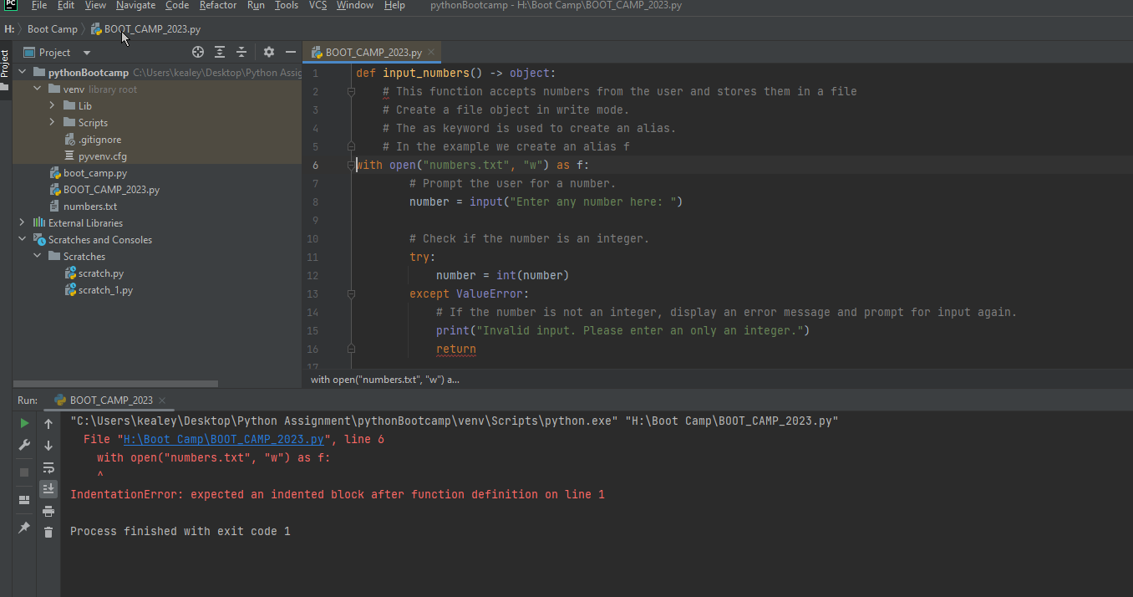
Debugging
The comments are not indented under the function, so Python thinks the function body is missing. Every line inside the function must be indented.

Slide 14
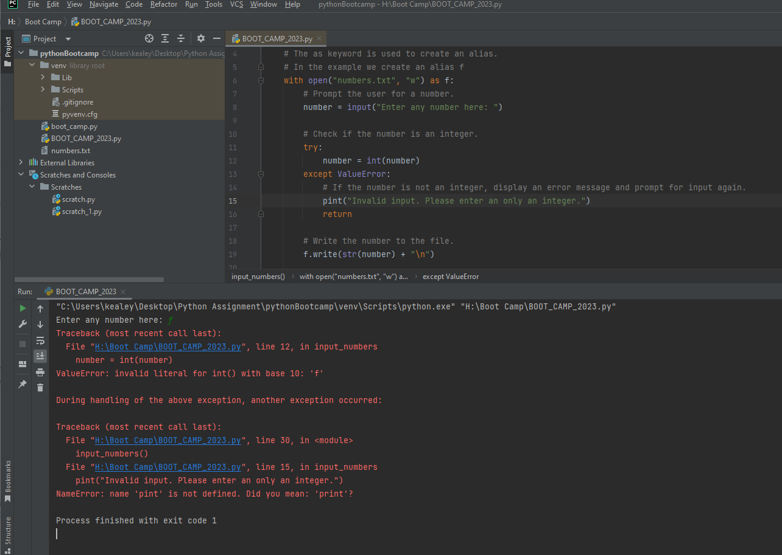
Debugging
Here, the first error comes from entering f when it asked Enter any number here:. Python tried to convert "f" into an integer → int("f"), which is invalid.That part is expected, because you are handling invalid input with try/except.
The real error is at line 15:pint("Invalid input. Please enter an only an integer.") You accidentally typed pint instead of print.

Slide 15

Google Colaboratory: Python in the Cloud
Google Colaboratory, or "Colab" for short, is a cloud-based Jupyter notebook environment that requires no setup and runs entirely in the cloud. It is a product from Google Research that allows you to write and execute Python code through your browser.
Python Integration
Built for Python: Colab is specifically designed to work with Python, supporting all major Python libraries
Pre-installed Libraries: Comes with popular data science packages already installed (NumPy, Pandas, Matplotlib, TensorFlow, PyTorch)
Seamless Execution: Run Python code cells individually or in sequence with simple keyboard shortcuts
Key Capabilities
Free GPU/TPU Access: Provides free access to GPUs and TPUs for accelerated computing
Google Drive Integration: Connect directly to your Google Drive for saving and loading files
Collaborative Features: Share notebooks with others for real-time collaboration
Rich Output Display: Visualize data with interactive charts, graphs, and multimedia
No Local Environment Needed: Everything runs in the cloud—no need for local Python installation

Slide 16
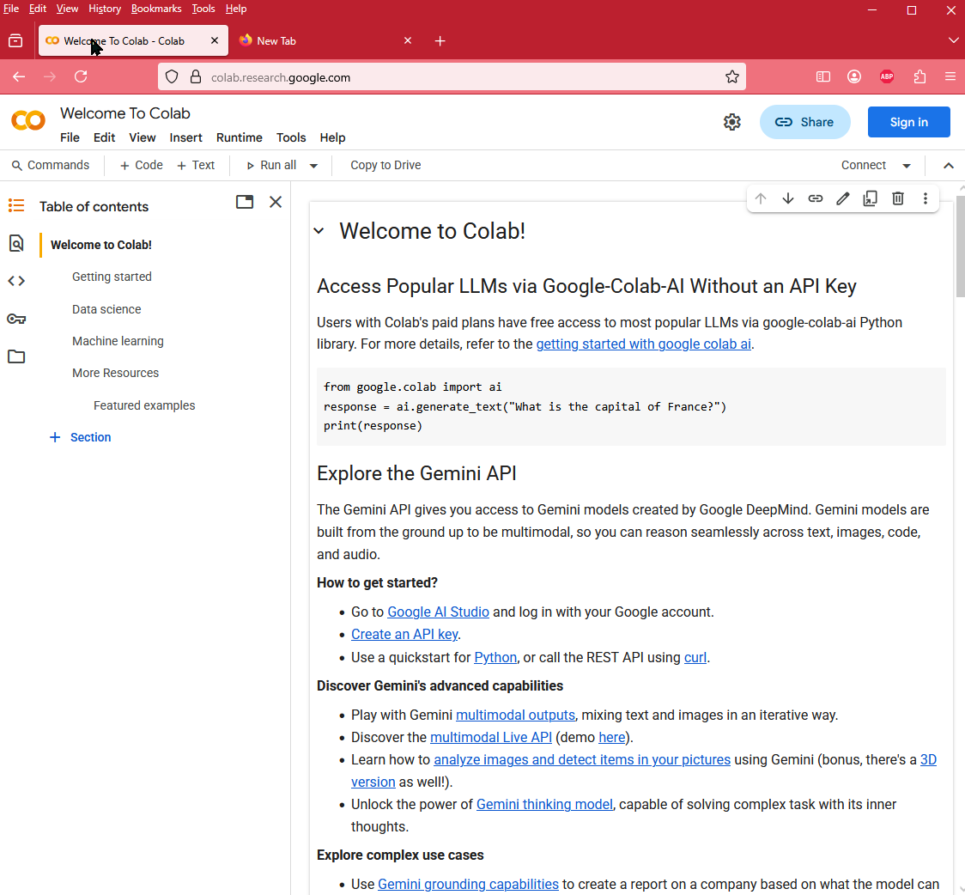
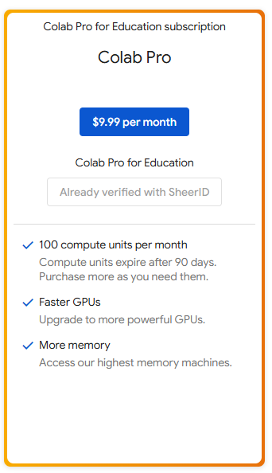
Python and Colab
https://colab.research.google.com/
Data analysis and visualization
Machine learning and deep learning model development

Slide 17
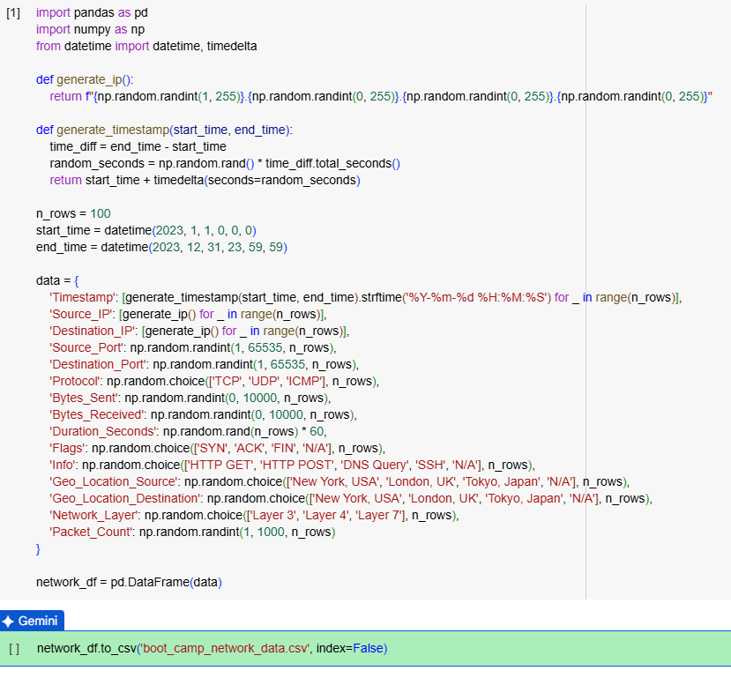
Generate a network traffic CSV file
Prompt to generate a network traffic CSV file:
# Generate a CSV file containing simulated network traffic data. Call it Boot_Camp_Netwoek Traffic
# The CSV should have at least 100 rows and include the following columns:
# - Timestamp: The date and time of the network event (format: YYYY-MM-DD HH:MM:SS)
# - Source_IP: The source IP address
# - Destination_IP: The destination IP address
# - Source_Port: The source port number
# - Destination_Port: The destination port number
# - Protocol: The network protocol (e.g., TCP, UDP, ICMP)
# - Bytes_Sent: The number of bytes sent in the network event
# - Bytes_Received: The number of bytes received in the network event
# - Duration_Seconds: The duration of the network connection in seconds
# - Flags: TCP flags (e.g., SYN, ACK, FIN) or other protocol-specific flags
# - Info: Additional information about the network traffic (e.g., HTTP request method, DNS query type)
# - Geo_Location_Source: Geographical location of the source IP address (e.g., City, Country)
# - Geo_Location_Destination: Geographical location of the destination IP address (e.g., City, Country)
# - Network_Layer: The network layer (e.g., Layer 3, Layer 4, Layer 7)
# - Packet_Count: The number of packets exchanged in the network event
Analyze the network traffic data. The Process
Generate the code: Generate the code to create a pandas DataFrame with sample network traffic data in the selected cell.
Load the data: Load the network_traffic.csv file into a pandas DataFrame.
Explore the data: Display the first few rows, check the data types, and look at summary statistics to understand the dataset.
Basic analysis: Perform some basic analysis, such as checking the distribution of protocols, ports, or geographical locations.
Finish task: Summarize the findings and present them clearly.

Slide 18
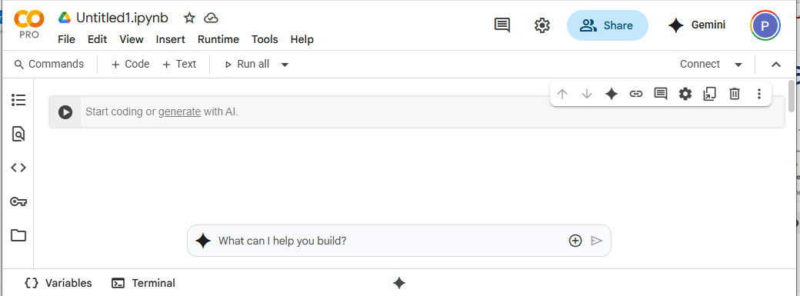
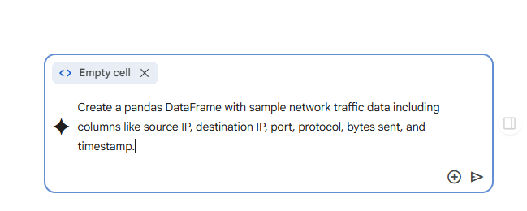
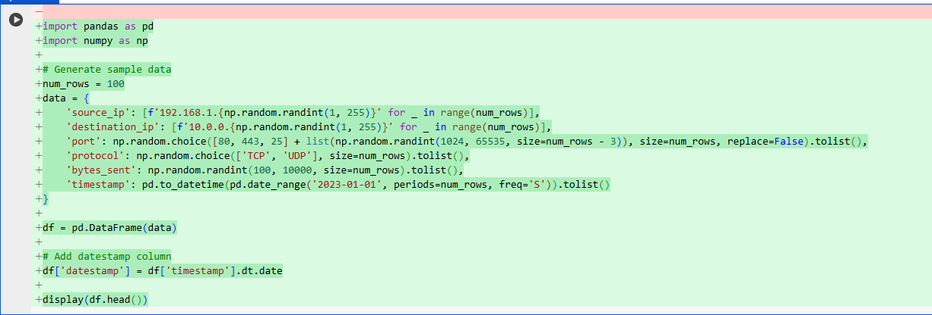
Create a Notebook and analyze network traffic
Create sample network traffic data
File- New Notebook on Drive
Select Generate with AI
Generate sample data using the previous prompt:
Examine the Python Code
Accept and Run
Save data to csv: Save the generated DataFrame to a CSV file.
Display sample data: Display the first few rows of the generated DataFrame to show the user the data.
Finish task: Inform the user that the sample data has been generated and saved to a CSV file.
Create sample network traffic data

Slide 19
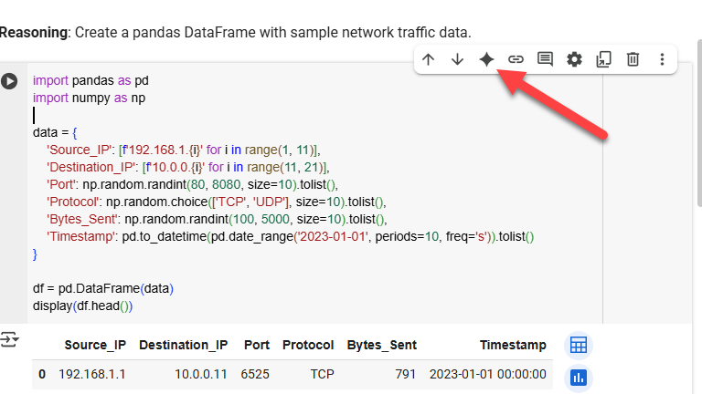
Explain the Code
Import Libraries:
It imports pandas for data manipulation and numpy for numerical operations.
Create Data Dictionary: A dictionary data is created to hold lists for each column:
Source_IP: Generates a list of sample source IP addresses.
Destination_IP: Generates a list of sample destination IP addresses.
Port: Generates a list of random port numbers between 80 and 8080.
Protocol: Randomly selects 'TCP' or 'UDP' for each entry.
Bytes_Sent: Generates a list of random byte counts between 100 and 5000.
Timestamp: Creates a list of timestamps starting from '2023-01-01' with 1-second intervals.
Create DataFrame: The data dictionary is used to create a Pandas DataFrame named df.
Display Head: display(df.head()) shows the first 5 rows of the created DataFrame to give a preview of the generated data.

Slide 20
Sample Network Analysis
Load the data: Load the network traffic data from the CSV file into a pandas DataFrame.
Analyze traffic volume: Calculate the total bytes sent and the number of connections for each protocol (TCP and UDP).
Identify top talkers: Find the top source and destination IP addresses based on the number of bytes sent or connections.
Analyze port usage: Determine the most frequently used ports and their associated protocols.
Analyze traffic over time: Analyze the traffic volume over time to identify patterns or anomalies.
Finish task: Summarize the types of analysis performed and suggest potential next steps, such as visualizing the results or performing more advanced analysis.

Slide 21
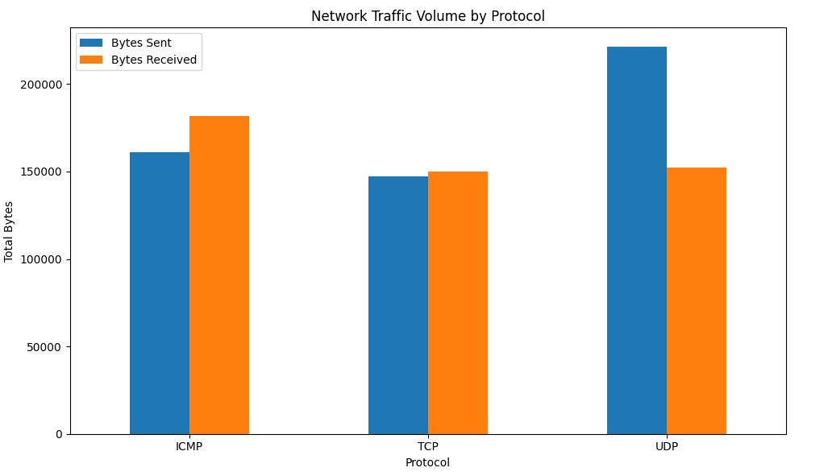
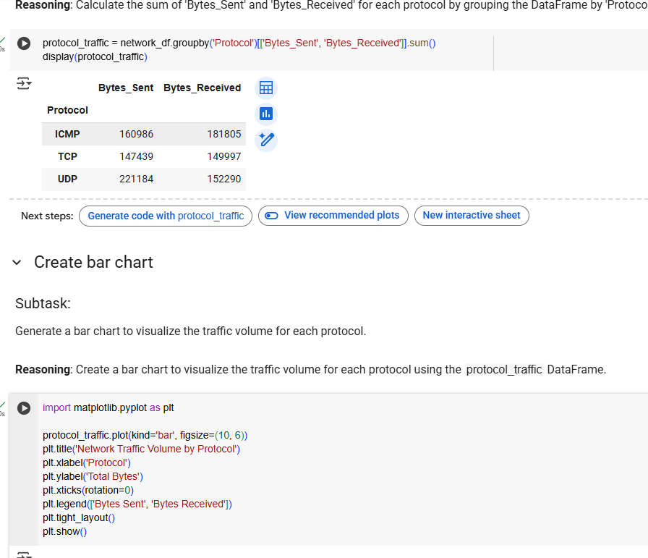
Bar chart showing the traffic volume by protocol
PROMPT: bar chart showing the traffic volume by protocol.

Slide 22
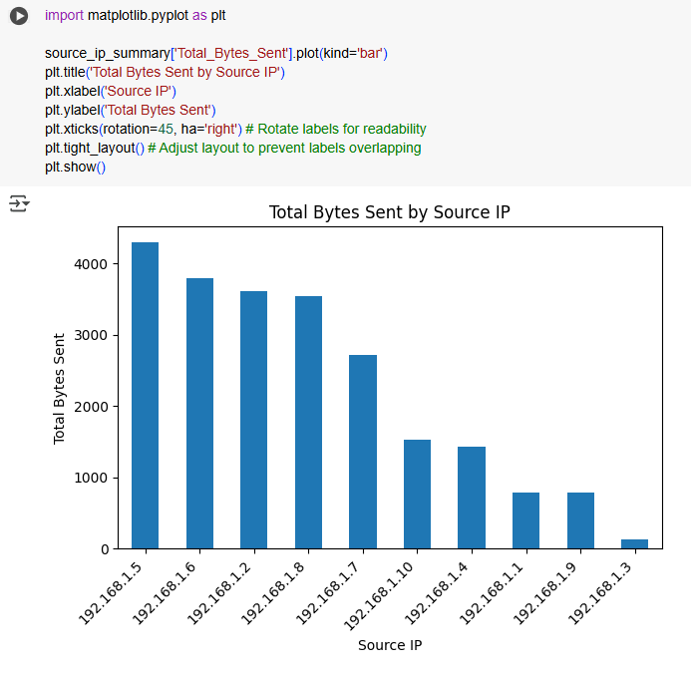
Bar chart showing the total bytes sent IP addresses
PROMPT: a bar chart showing the total bytes sent by the top source IP addresses
This helps illustrate the concept of "top talkers" and can spark discussions about identifying potential sources of high traffic, which could be normal behavior or indicate something unusual.

Slide 23
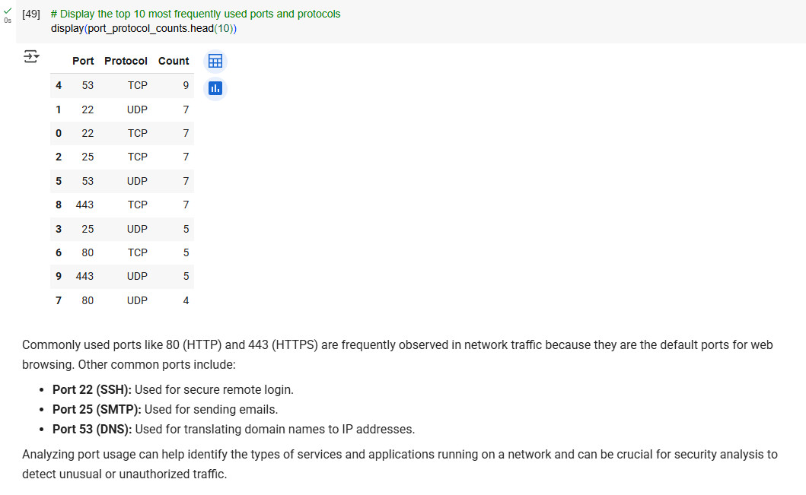
Analyze frequently used ports
PROMPT: Analyze frequently used ports in more detail: Investigate the port_protocol_counts DataFrame further to identify the top ports and discuss why certain ports are more frequently used (e.g., port 80 for HTTP, 443 for HTTPS).

Slide 24
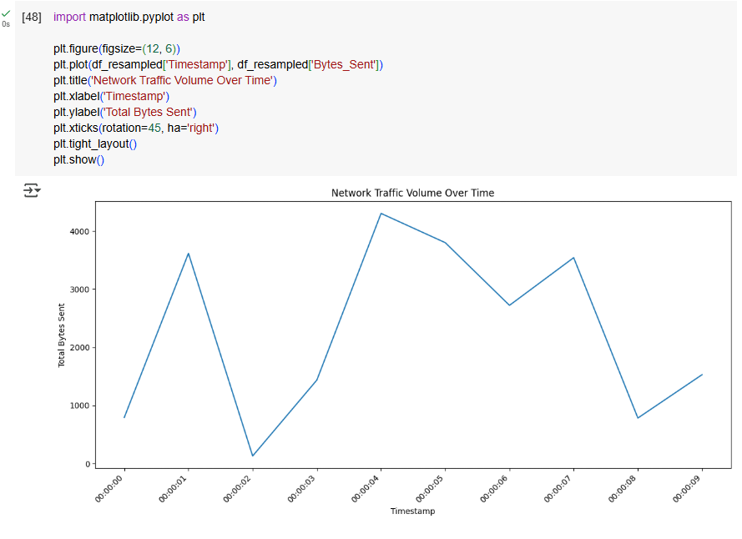
Visualize the traffic volume over time to identify patterns or anomalies
The plot shows the network traffic volume (total bytes sent) over time, sampled every second.
In a real-world scenario, this type of visualization can reveal:
Traffic patterns: You might see consistent peaks and valleys indicating busy and idle periods.
Anomalies: Sudden spikes or drops in traffic could indicate unusual events, such as a large data transfer, a denial-of-service attack, or a network issue.
Since our data is randomly generated, the plot shows a somewhat random fluctuation in traffic volume. In a real network, you would look for more meaningful patterns.

Slide 25
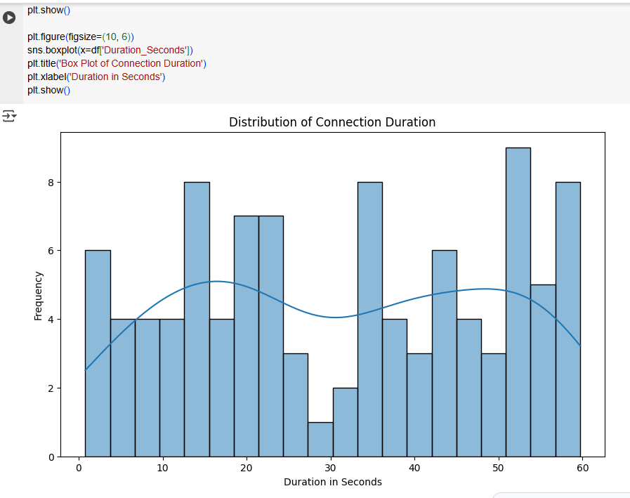
Duration Analysis
Prompt: Analyze the duration of connections to identify unusually long or short connections.

Slide 26
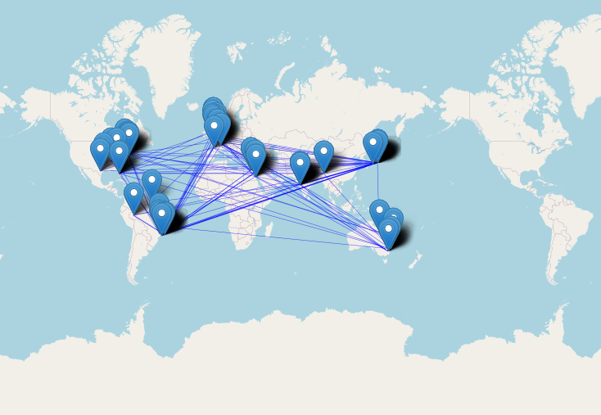
Geographical Traffic Flow
Nominatim → a geocoding service (based on OpenStreetMap). It converts addresses to latitude/longitude (geocoding) or the reverse (reverse geocoding).
RateLimiter → a helper to avoid sending too many requests too quickly, since Nominatim enforces usage limits.
Extract city and country: Extract the city and country information from the 'Geo_Location_Source' and 'Geo_Location_Destination' columns.
Aggregate traffic by location pairs: Group the data by source and destination location pairs and count the number of events or sum relevant metrics (e.g., bytes sent/received) for each pair.
Visualize the traffic flow between different geographical locations based on the 'Geo_Location_Source' and 'Geo_Location_Destination' columns.
Visualizing geographical traffic flow is a great idea! It can help identify where your network traffic is coming from and going to.

Slide 27
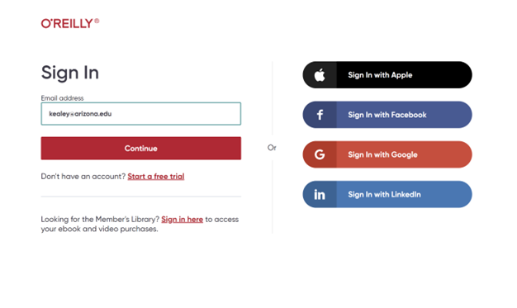


Resources

Slide 28
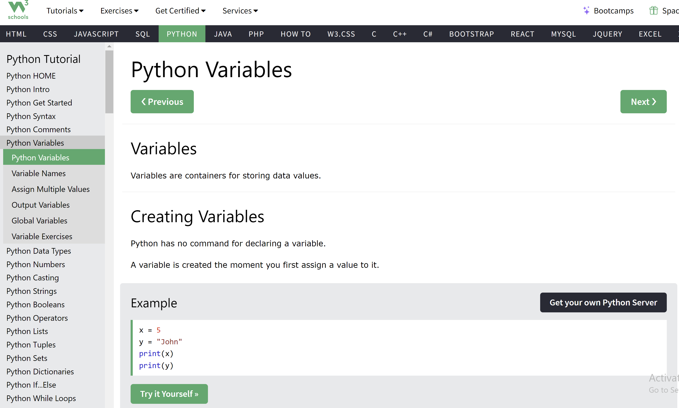

Slide 29

Resources

Slide 30
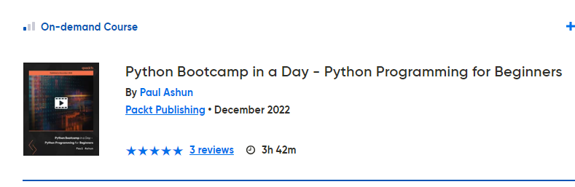
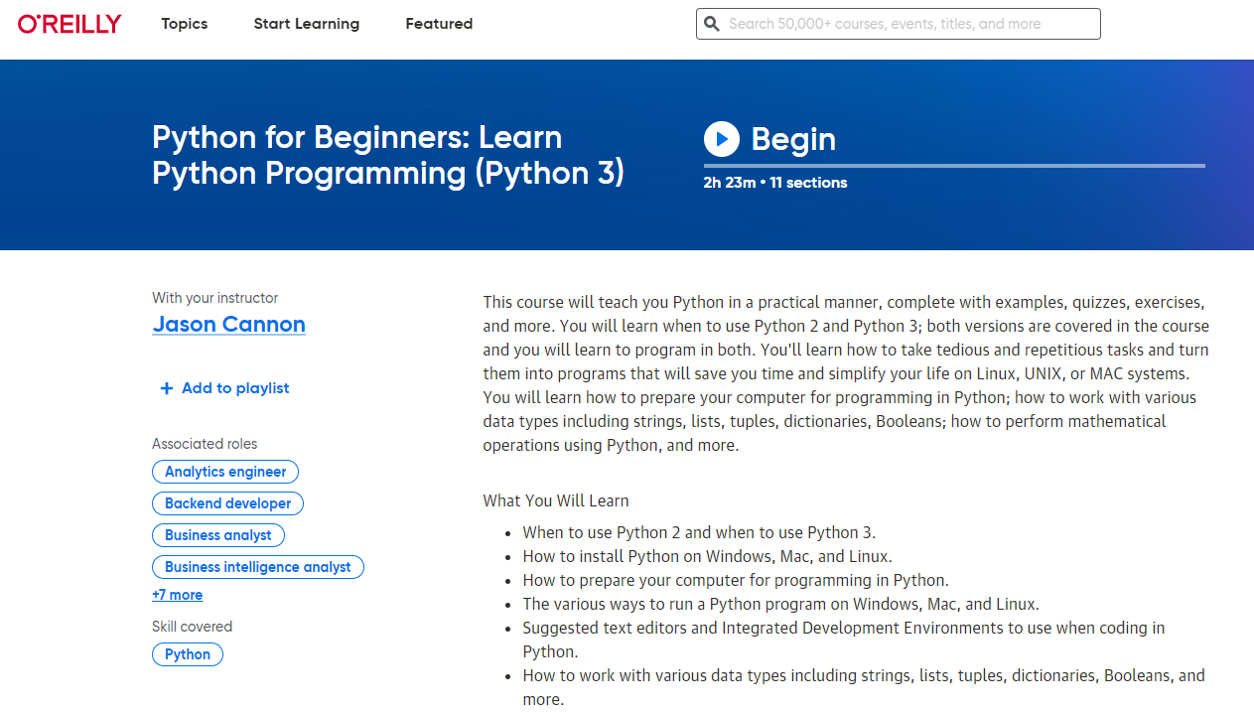
Resources

Slide 31

Resources
https://www.w3schools.com/python/default.asp
https://www.Oreilly.com
https://www.jetbrains.com/help/pycharm/2023.2/getting-started.html

Slide 32
Questions?

